Slide 1
Jubeen Shah
Brandon Johnson
Second Meetup

Slide 2
Agenda
School of Ai - Raleigh
From data to information
Business Impact of AI
Pandas
NumPy
Matplotlib

Slide 3
Agenda
School of Ai - Raleigh
From data to information
Business Impact of AI
Pandas
NumPy
Matplotlib

Slide 4

From data to information

Slide 5





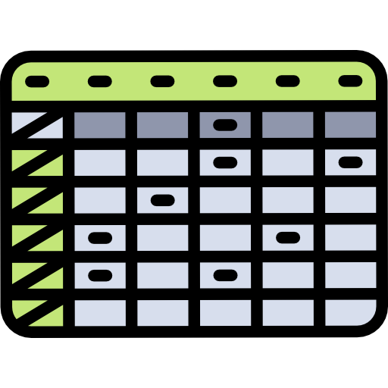


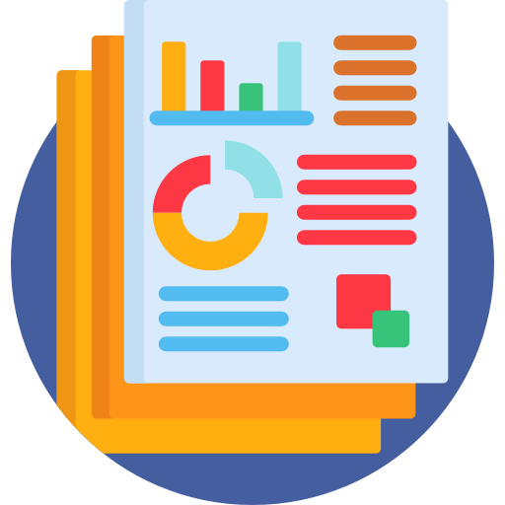

Idea
Brainstorming
Data extraction
Data summarization
Data processing

Slide 6


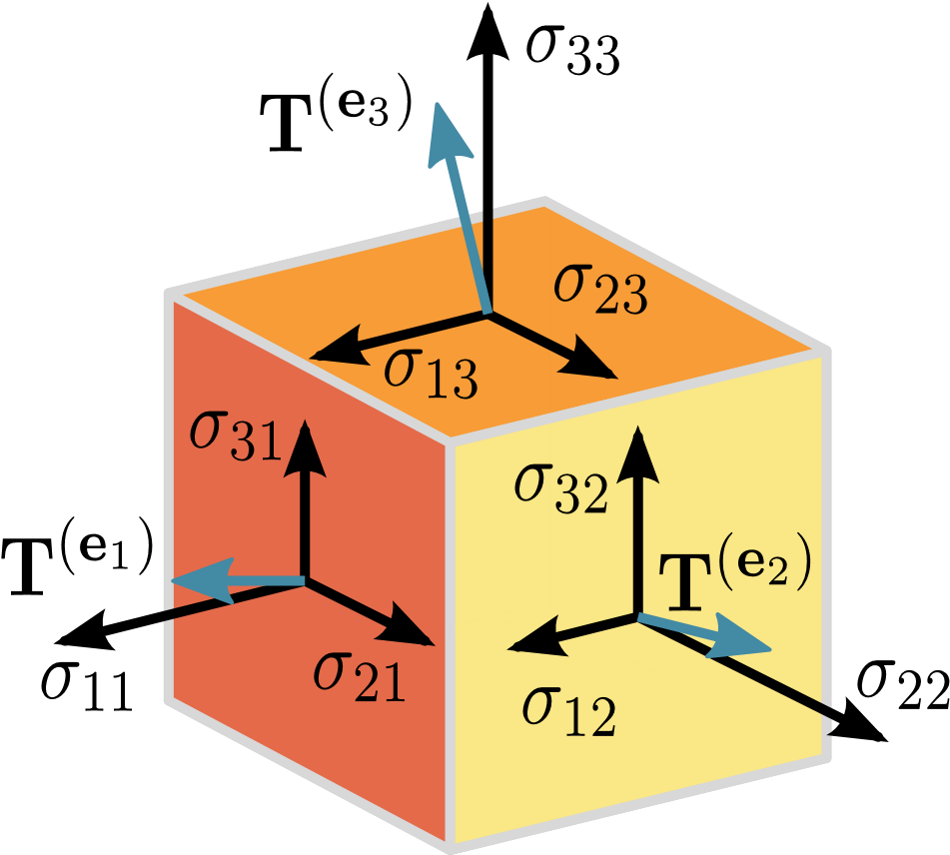

Data extraction
Data summarization
Data processing

Slide 7

Data summarization

Slide 8
Agenda
School of Ai - Raleigh
From data to information
Business Impact of AI
Pandas
NumPy
Matplotlib

Slide 9
Karen McCann
Founder — AI Now - RTP

Slide 10
Balaji Kannaiyan

Slide 11
Ethics in AI
School of Ai - Raleigh
Ethics — The moral experiment machine

Slide 12
Agenda
School of Ai - Raleigh
From data to information
Business Impact of AI
Pandas
NumPy
Matplotlib

Slide 13
Pandas
What is

Slide 14
Pandas
School of ai - Raleigh
Powerful data analysis toolkit
Documentation

Slide 15
Reading from a csv file
School of ai - Raleigh
Why CSV?
Great for starters like you and me
Easily available
Easy to read
Awesome for simple data analysis
Link

Slide 16
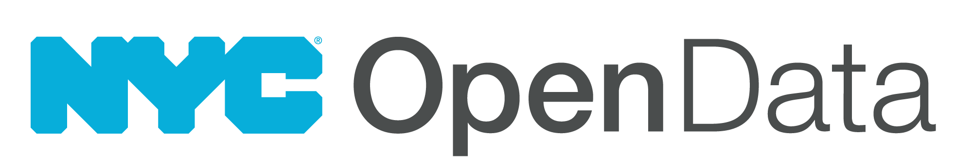
Summarizing data
School of ai - Raleigh
Let’s analyze the NYC Open Data for 311 service calls
Business Requirement
Find the most common complaint type
Link

Slide 17
Summarizing data
School of ai - Raleigh
Let’s analyze the NYC Open Data for 311 service calls
Business Requirement
Which borough has the most noise complaints?
Link

Slide 18
Adding information
School of ai - Raleigh
Let’s analyze the bike ride data
Business Requirement
Find out on which weekday do people bike the most
Link

Slide 19
Cleaning up messy data
School of ai - Raleigh
The data you get would always be messy
Missing data
Anomalous data
Errors in data
Link

Slide 20
Loading data from sql database
School of ai - Raleigh
Link

Slide 21
Agenda
School of Ai - Raleigh
From data to information
Business Impact of AI
Pandas
NumPy
Matplotlib

Slide 22
Numpy
What is

Slide 23
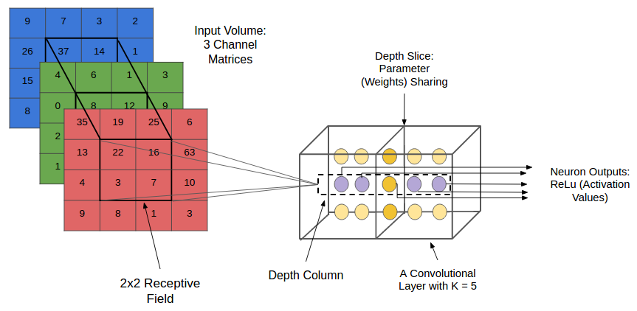
Numpy
School of Ai - Raleigh
Scientific Computing
Fast mathematical operations
Primarily we would work with arrays and matrices

Slide 24
Numpy
School of Ai - Raleigh
Scientific Computing
Fast mathematical operations
Primarily we would work with arrays and matrices

Slide 25
Numpy
School of Ai - Raleigh
NumPy Tutorial — Link
NumPy Quiz — Link
NumPy Quiz Solution — Link

Slide 26
Agenda
School of Ai - Raleigh
From data to information
Business Impact of AI
Pandas
NumPy
Matplotlib

Slide 27
Matplotlib
What is

Slide 28
Matplotlib
School of Ai - Raleigh
Matplotlib is a library for producing publication-quality figures. MPL (for short) was designed from the beginning to serve two purposes:
allow for interactive, cross-platform control of figures and plots
make it easy to produce static raster or vector graphics files without the need for any GUIs.
Furthermore, MPL — much like Python itself —gives the developer complete control over the appearance of their plots, while still being very usable through a powerful defaults system.

Slide 29
Notebooks
School of Ai - Raleigh
Chapter 1 - Subplots and Layouts
Chapter 2 - Plotting Methods : Overview
Chapter 3 - Speaking MPL
Chapter 4 - Limits, Legends, and Layouts
Chapter 5 - Artists
Chapter 6 - MPL Tool Kits

Slide 30
Agenda
School of Ai - Raleigh
From data to information
Business Impact of AI
Pandas
NumPy
Matplotlib

Slide 31
Agenda
School of Ai - Raleigh
From data to information
Business Impact of AI
Pandas
NumPy
Matplotlib
TensorFlow

Slide 32
Tensorflow
What is

Slide 33
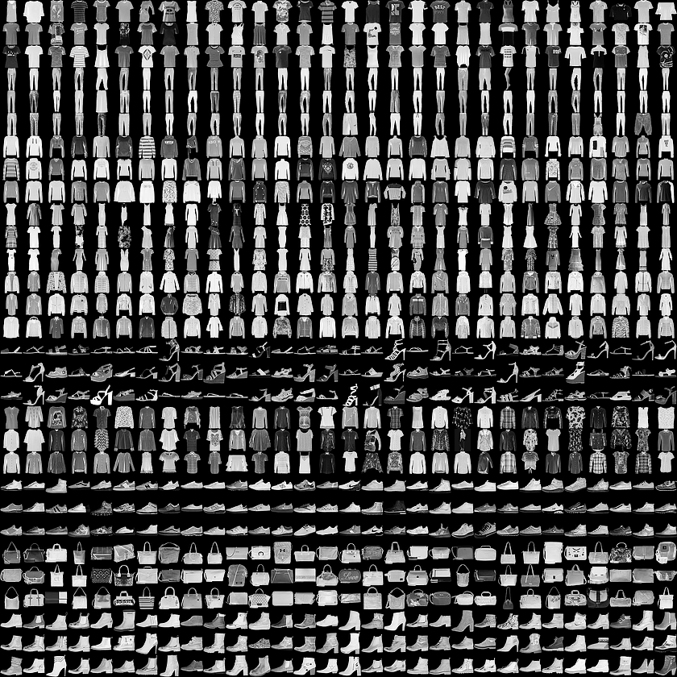
Classification
School of Ai - Raleigh
The first notebook is a basic Classification Notebook using the Fashion MNIST dataset which contains 70,000 grayscale images in 10 categories.
This guide trains a neural network model to classify images of clothing, like sneakers and shirts.

Slide 34

Text Classification
School of Ai - Raleigh
The second notebook is a text classification example that makes use of the reviews from IMBD dataset as positive or negative.

Slide 35
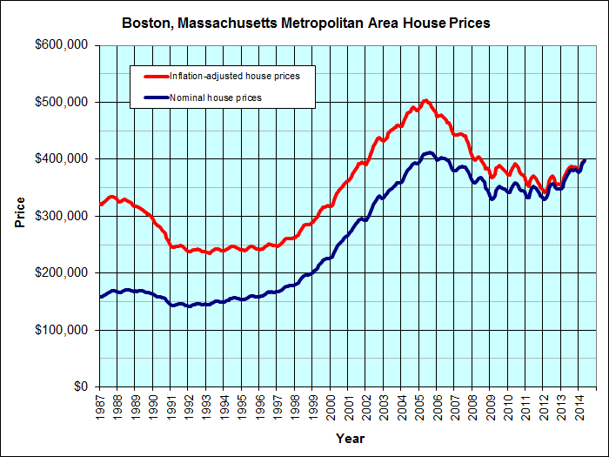
Regression
School of Ai - Raleigh
The third notebook is regressions notebook for the boston housing prices dataset.

Slide 36
Overfitting and underfitting
School of Ai - Raleigh
The fourth notebook is focussed towards overfitting and underfitting data.
In this notebook, we'll explore two common regularization techniques—weight regularization and dropout—and use them to improve our IMDB movie review classification notebook.

Slide 37
TensorFlow
School of Ai - Raleigh
Basics
Hello World notebook will help you set up your environment if you're having problems with setting up the TensorFlow environment, or haven't done it yet.
Understanding tensors notebook will help you understand the basics of the tensors and setting up sessions for running your code.
Working with Inputs notebook will help you gain understanding about how you can give inputs to the session variable you define in TensorFlow using feed_dict

Slide 38
Tensorflow
School of Ai - Raleigh
Basics
TensorFlow math notebook will help you gain familiarity with performing math operations using TensorFlow. Be advised, this is a bit different than your usual programming practices.
Declaring Tensors notebook is aimed towards helping you understand different types of tensors.
Placeholders and Variables notebook is aimed towards making your foundations strong by helping you understand placeholders and variables for your data.

Slide 39
Some (relatively) advanced topics
School of Ai - Raleigh
Intro to TensorFlow
Softmax in TensorFlow
Cross Entropy
MiniBatching
MNIST in TensorFlow

Slide 40
Ai in security

Slide 41


